Slide 1
Screen Sample for Final Project
Project Name: Fraction Runner
Team Harem:
Junquan Lin, Brandon Her,
Jose Acosta, John

Slide 2
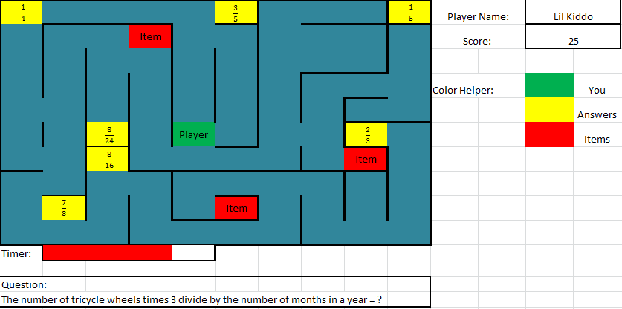
Floor One Maze

Slide 3
Description
Right side would be a display board of player info and helping info.
Bottom side would be used for the game itself displaying questions and timer for player.
Rest of the display would be the maze with walls and collectables including answers and items. Player would be spawned near the center of maze to start with given certain amount of time to answer question given.

Slide 4
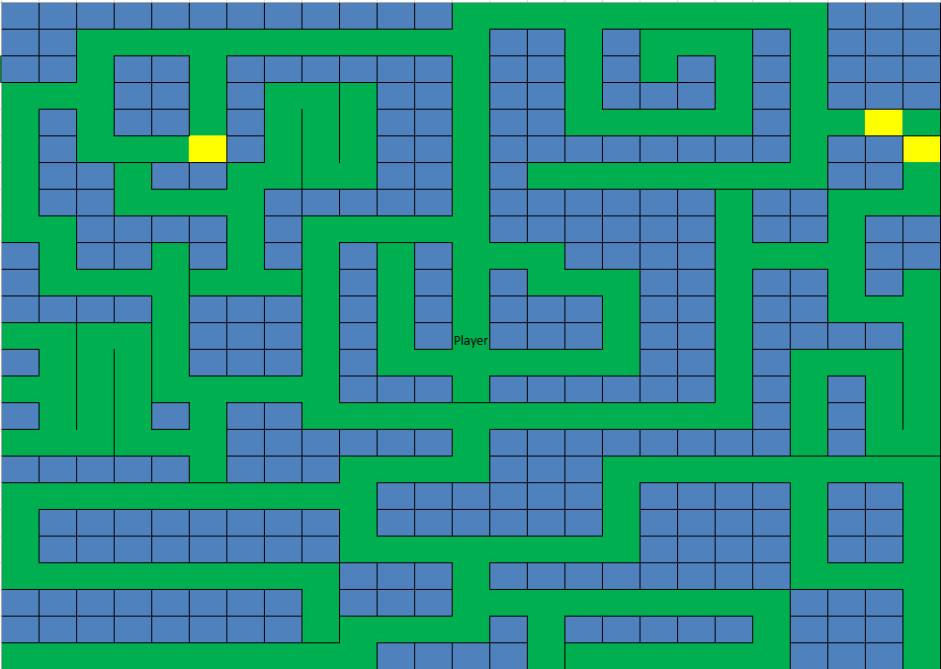
Other Floor Design

